Slide 1
Garbage
Classifier
By:- Ravindranath Sawane & Om Rachalwar
Project for MAISHacks 2021

Slide 2
TOC
Overview
Understanding the problems
Project objective
Target of Project
Demonstration

Slide 3
Overview
A Object Detection approach to classify garbage into recycling cat-
egories could be an efﬁcient way to process waste. This project aims to take garbage waste images and classify them into four classes: glass, paper, metal and, plastic. We use a garbage image database that contains around 400 images for each class. The models used in the experiments are Pre-trained VGG-16 (VGG16), AlexNet, Support Vector Machine (SVM), K-Nearest Neighbor (KNN) and, Random Forest (RF). Experiments showed that our models reached accuracy around 82%

Slide 4
Understanding the problems
01
The Waste in today's world is generated from every household and in many of the countries the waste management companies do not classify and dump as it is so its harmful.
02
The Waste can be Medical and Radioactive sometimes it can damage the Environment when not disaggregated.

Slide 5
Garbage Problem
Burying garbage also causes both air and water pollution, and simply transporting it to the sites consumes an increasing amount of valuable fossil fuels, which produces more pollution and other problems. Buried in a landfill, the typical plastic trash bag takes 1,000 years to degrade, giving off toxins as it does.

Slide 6
Project objective
Careful and robust classification of waste materials is important given the strict controls required for storage, treatment and disposal of hazardous waste, in addition to the higher costs involved compared with other waste types. It is also important to ensure that wastes are disposed of in the correct landfill sites.

Slide 7
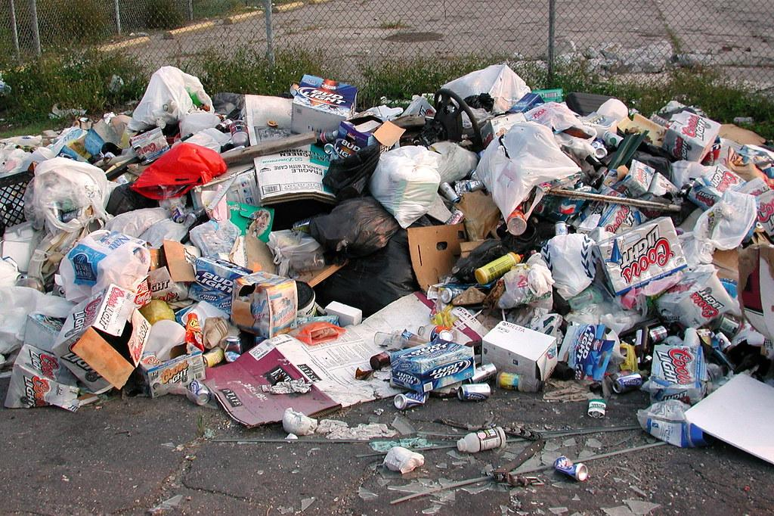
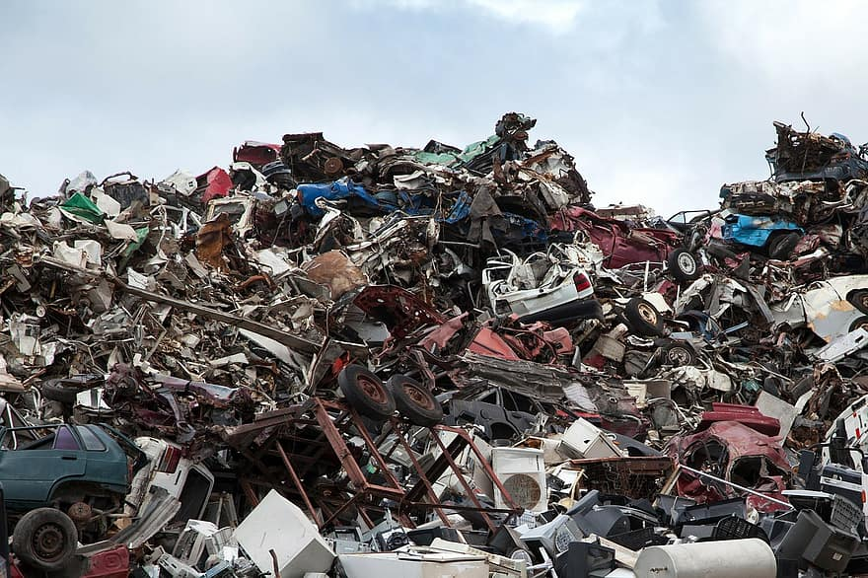
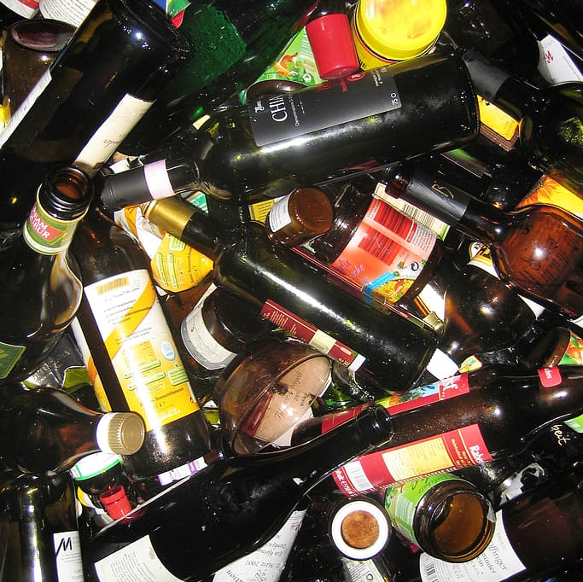
Target of Project
The target of this project is the companies with no classification methods for waste management and the Government Dump yards.

Slide 8
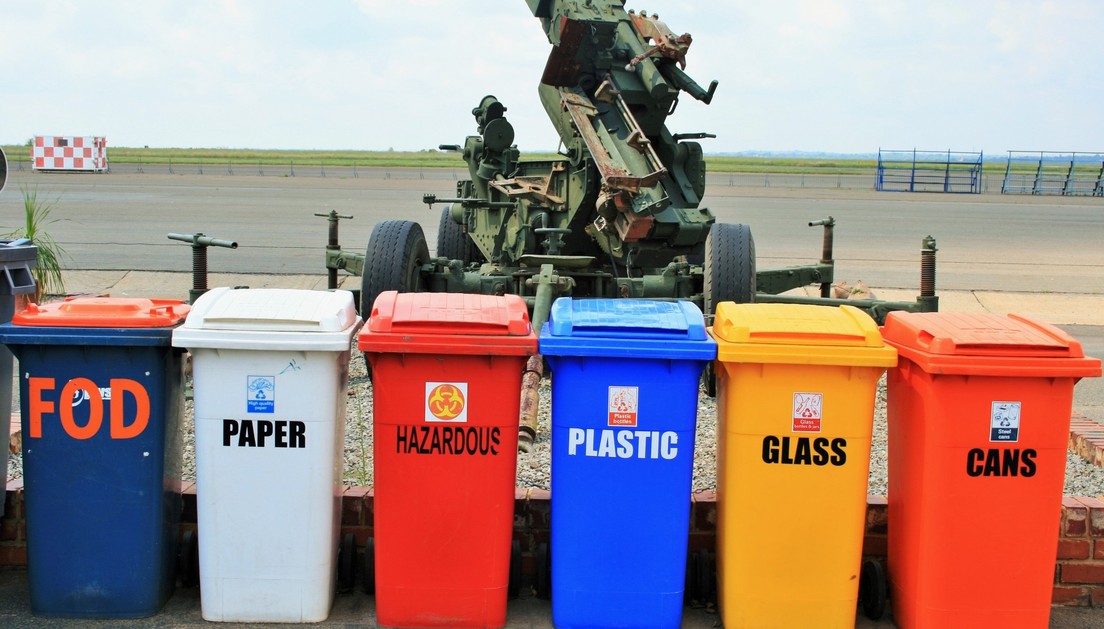
Thank you!

